Slide 1

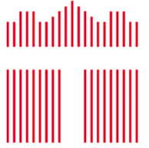

Image Stitching System Based on ORB Feature
Team 13
GITHUB LINK:
https://github.com/RitaWen/Image-Stitching-System-Based-on-ORB-feature

Slide 2
Outline
Image Stitching
Workflow and Algorithm
System Architecture and Spec
Design Optimization
Result

Slide 3
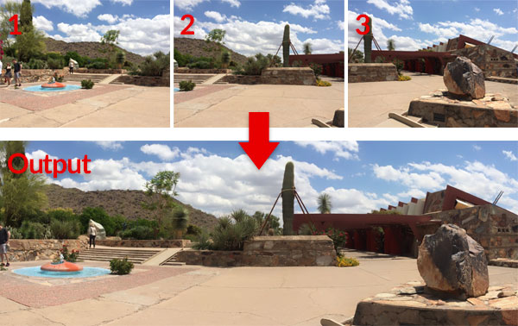
Image Stitching
Combine multiple images and create a panorama

Slide 4
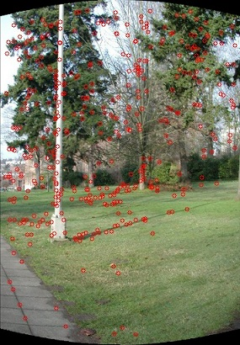
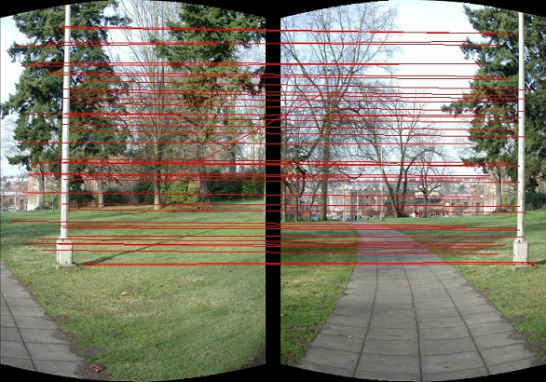
Workflow
Cylindrical projection
Keypoints extraction
ORB
(Oriented FAST and rotated BRIEF)
Feature description
Feature matching
RANSAC
Eliminate outliers
Determine relative positions of input images
Image blending

Slide 5
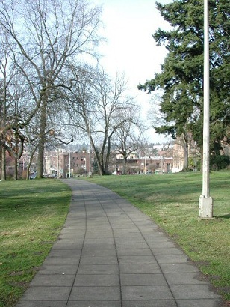
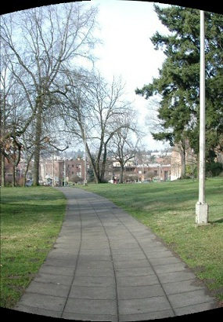
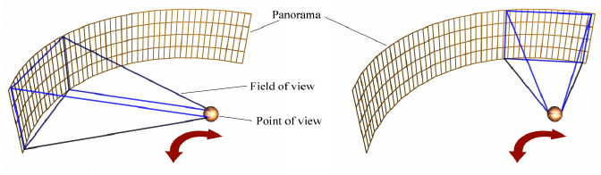
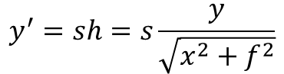
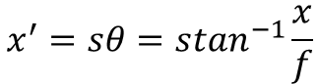
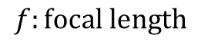
Cylindrical projection
$$x^{′}=sθ=s\tan^{−1}\frac{x}{f}$$
$$y^{′}=sh=s\frac{y}{\sqrt{x^{2}+f^{2}}}$$
$$f:focal length$$

Slide 6
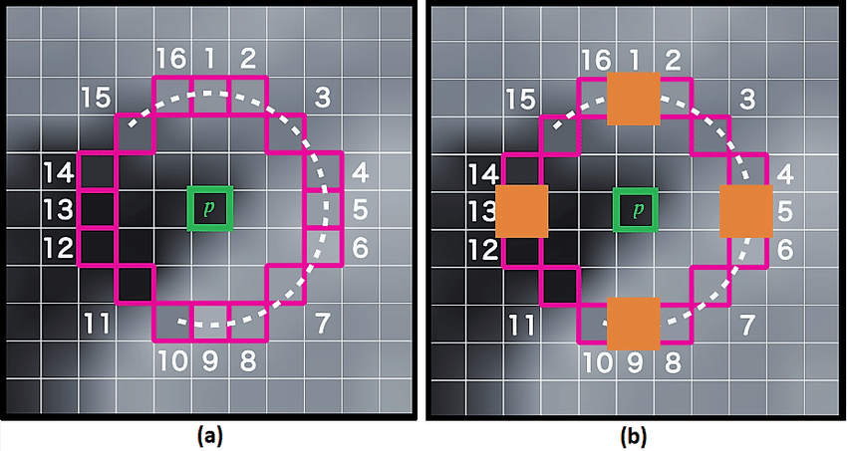
Keypoints extraction: FAST
Detect corners
P is a candidate if there are n consecutive all > P0+threshold or all < P0-threshold
Scoring: find V s.t. exactly n consecutive points all > P0+threshold or all < P0-threshold
n = 12

Slide 7
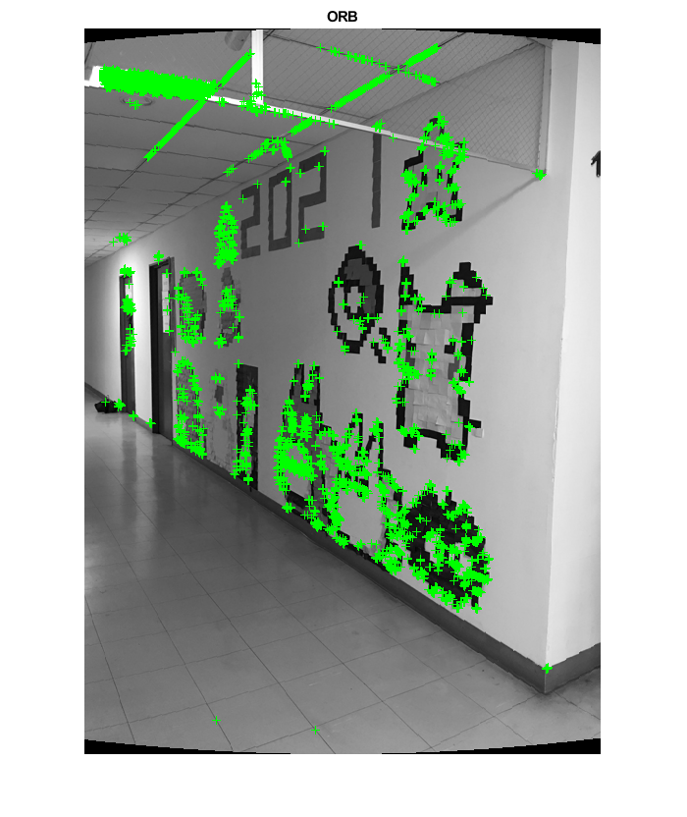
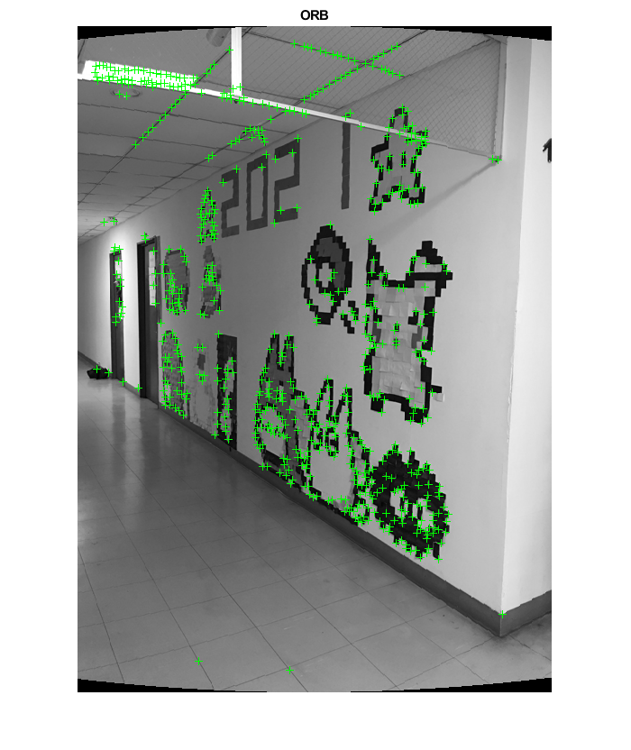
Keypoints extraction: FAST
NMS (non-maximum suppression)
Remove redundant points
Only keep one point with highest score in a 9x9 window

Slide 8
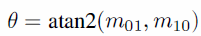
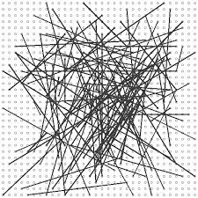
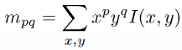
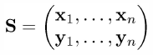
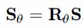
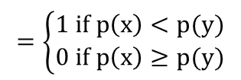
Feature description: BRIEF
Orientation:
Vector from a corner’s center to moment
BRIEF descriptor:
Binary test between two points in a patch
Test pairs N=256
rBRIEF:
Rotate binary tests
Patch 31x31
x
$$=\left\{\begin{matrix}1 if p\left(x\right)<p(y) \\ 0 if p\left(x\right)≥p(y)\end{matrix}\right.$$
y
Gaussian distribution
N = 256
V=[0 1 0 1 1 1 0 0…]
256 bits

Slide 9
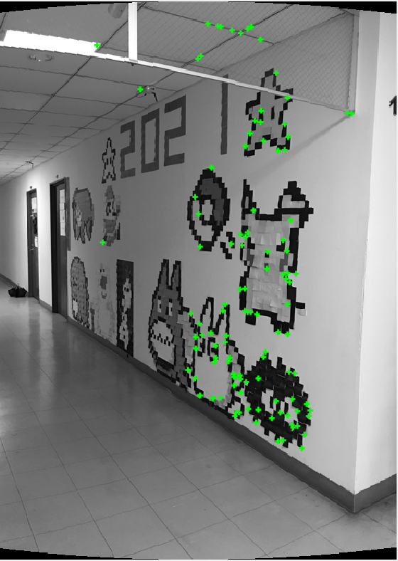
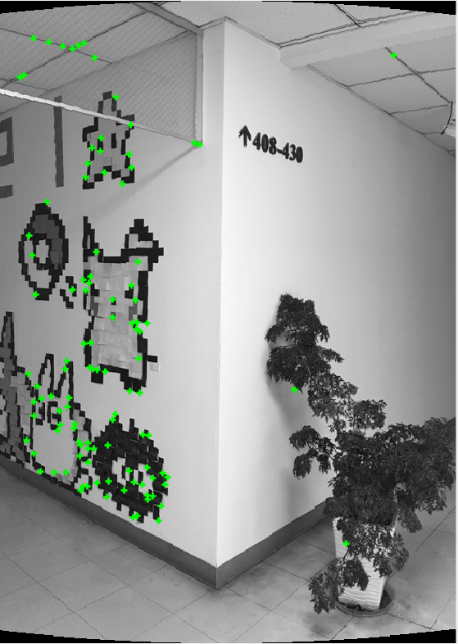
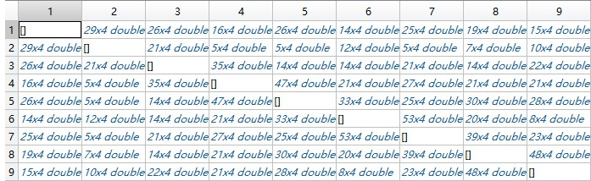
Feature matching
Hamming distance between two 256 bits descriptor
For each corner in fig1, find corners in fig2 with 1st and 2nd distance
Match: (1st dist / 2nd dist) < 0.5
Total n1*n2 times
#corners in fig1: n1
#corners in fig2: n2

Slide 10
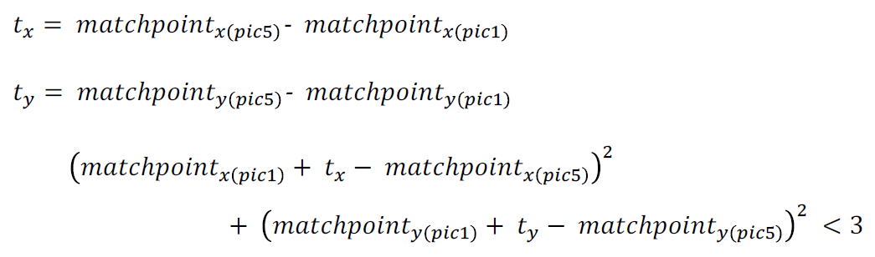
RANSAC
Eliminate outliers
Poll for best relative displacement:
Determine the offset and related position between images

Slide 11
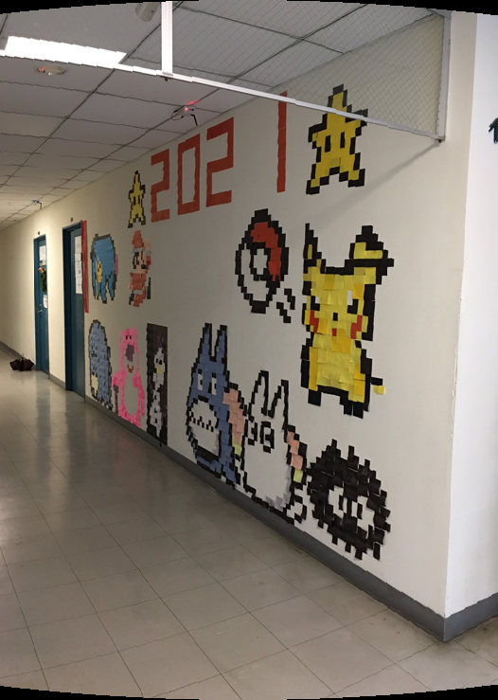
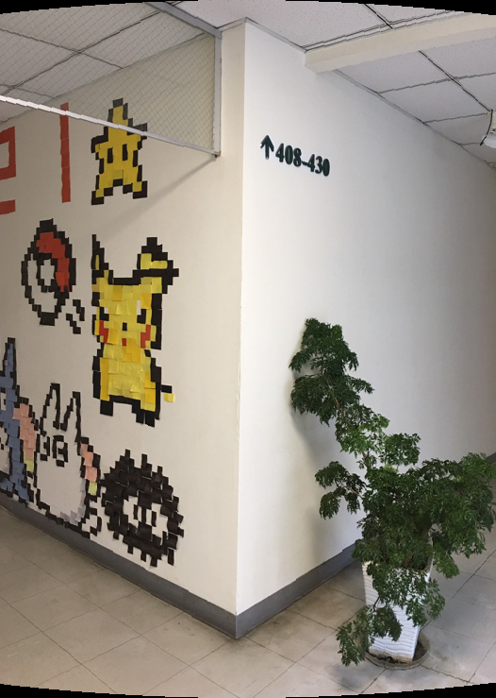
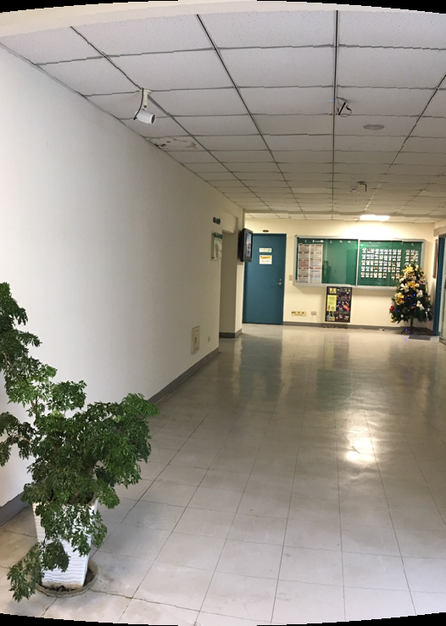
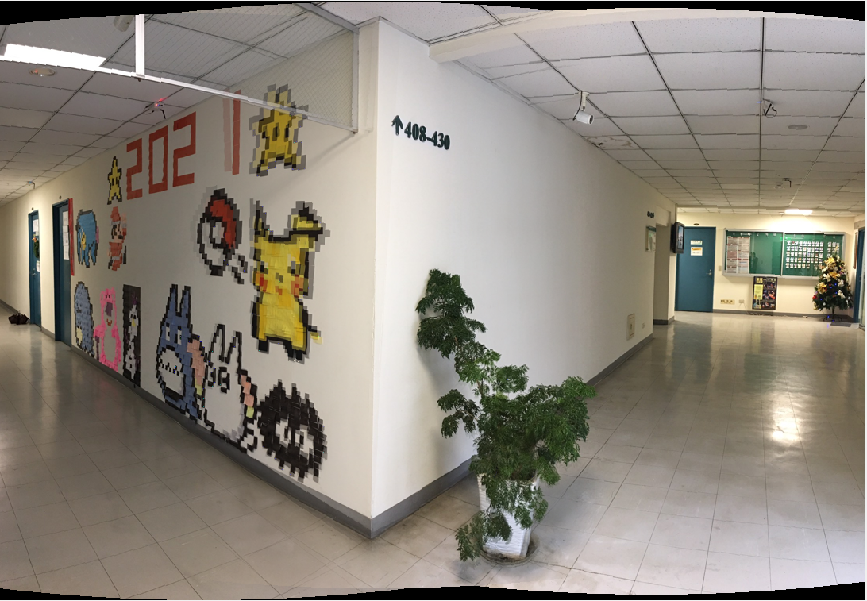
Image blending

Slide 12
Software implementation
Run on intel i7-10700 CPU @ 3.80GHz with MATLAB
Run time: 9 images of size 450x278
 | Run time (s) | Throughput (pixel/s)
Cylindrical projection | 2.380 | -
ORB | 45.784 | 2732.40
Feature matching | 57.355 | 160,000~640,000 (500~1000 corners)
RANSAC | 0.0110 | -
Blending | 3.351 | -
Total time | 110.061 | -
Bottleneck
Need to reduce run time and increase throughput!!

Slide 13
Target Spec
Speed-up: 10x
Target throughput:
 | intel i7-10700 CPU | Target
ORB | 2732 pixel/s | 27324 pixel/s
Feature matching | 160,000~640,000 pair/s | 1,000,000 pair/s
Achieve higher throughput and lower latency

Slide 14
System Architecture
PS
PL
Input
image
Cylindrical
Projection
Img_cyl
ORB
Kernel
feature
RANSAC
Matching
Kernel
Match_pt
Blending
Output image

Slide 15
ORB Kernel
FAST
NMS
Moment
Input
image
8’
Gaussian
Filter
Descriptor
32’
Output
Corners/descriptors
[D₁, D₂….D₁₀, X, Y]
32 bits integer*10
Ref: https://github.com/Siudya/ORB_FPGA?fbclid=IwAR3j4uoTPw_2FZh24xS1qVgnz4C3wclwXm9ZgUTw7_qJV7wVTXbjUrBJzDY

Slide 16
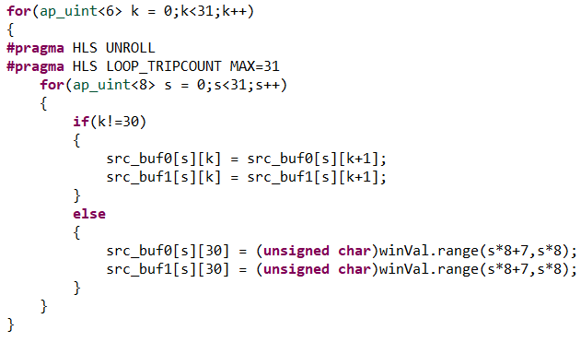
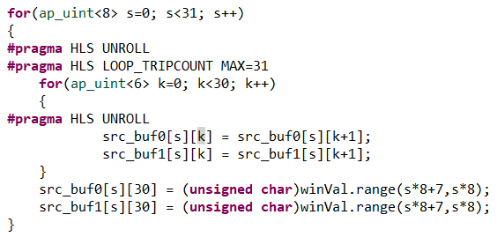
ORB Kernel - Optimization
Bottleneck: Descriptor (~83% run time of ORB)
If-else condition in for loop
Unroll

Slide 17
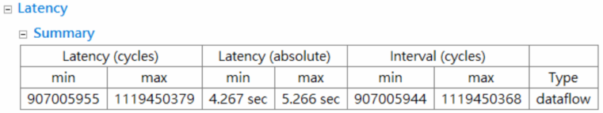
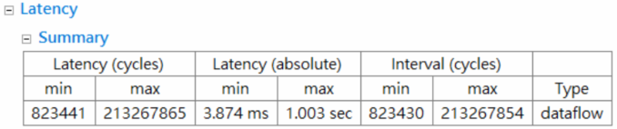
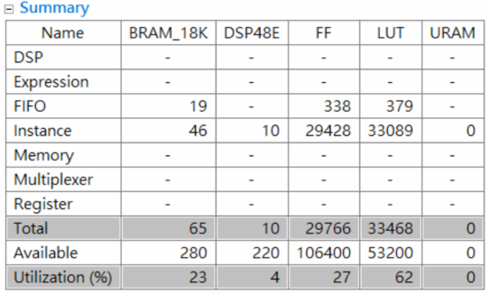
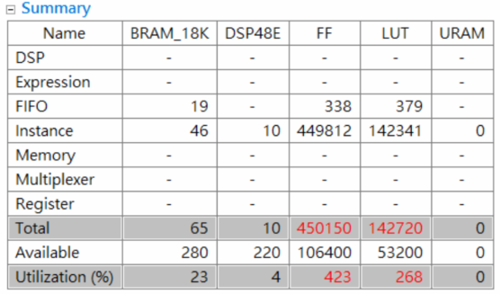
ORB Kernel - Optimization
Original
Unroll
Much shorter runtime, but insufficient resources…?

Slide 18
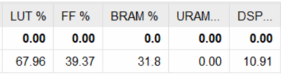
ORB Kernel
Clock Frequency: 160MHz
Actual Utilization:
HLS report is not accurate!!!
Vivado tool will optimize in APR.

Slide 19
ORB Kernel - Optimization
Larger window in NMS
Reduce corners -> Faster in calculate descriptor and feature matching
3 x 3: ~2000 keypoints/image
9 x 9: ~600 keypoints/image
Almost no degradation in quality (verified in software)

Slide 20
Matching Kernel
Hardware Implementation
32’
Hamming
distance
1st / 2nd
comparator
32’
Input
Corners/descriptors
Output
Matched points
[X₁Y₁, X₂Y₂]
(16, 16) bits integer*2
1st / 2nd
dist

Slide 21
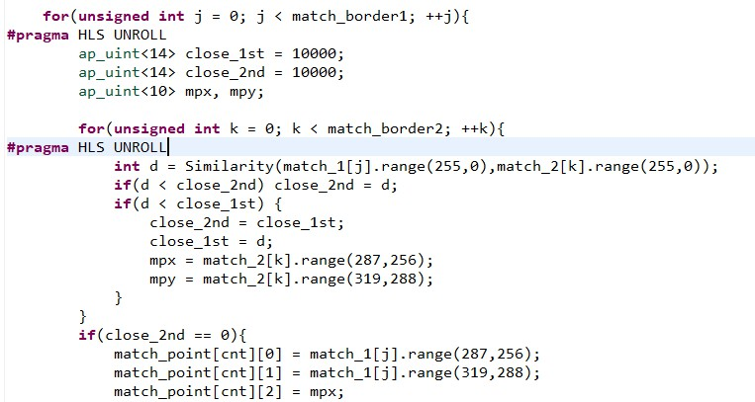
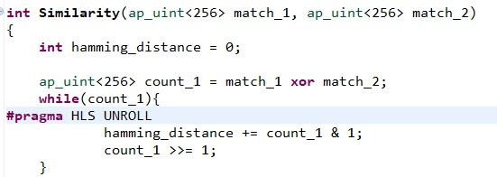
Matching Kernel - Optimization
Loop Unrolling (factor=256)
Compare multiple pairs concurrently
~5x faster compared to software implementation !!

Slide 22
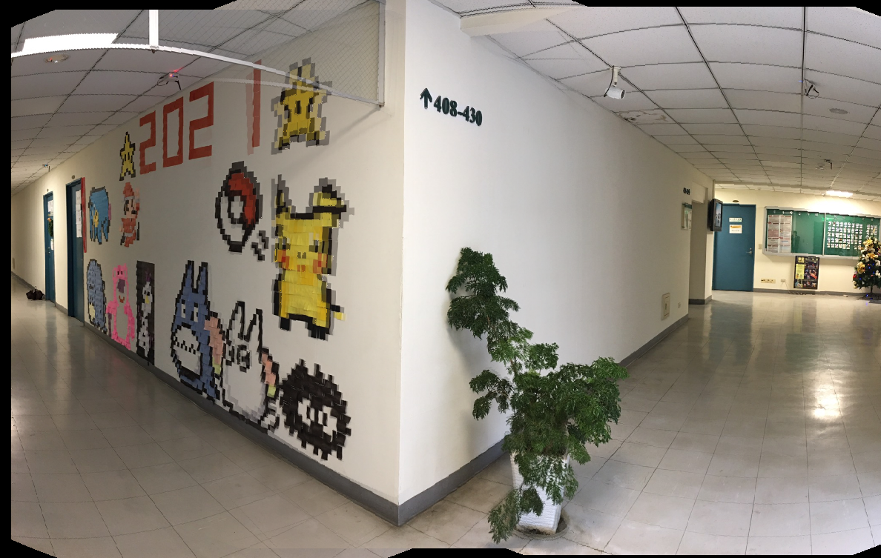
Result
BL430: 3 images with size 739x526

Slide 23
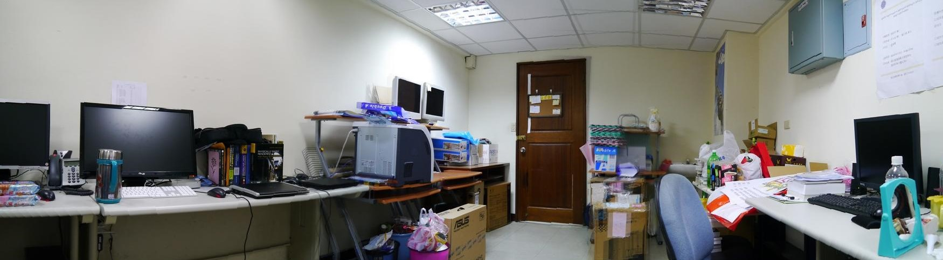
Result
Office: 3 images with size 534x756

Slide 24
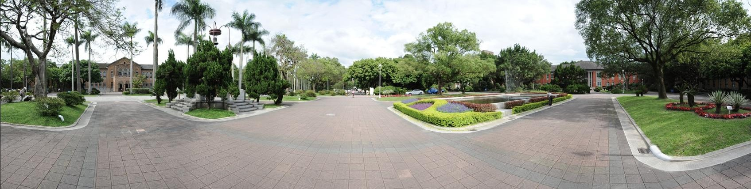
Result
傅鐘: 9 images of size 450x278

Slide 25
Runtime after acceleration
9 images of size 450x278
Run time
Throughput
 | Intel i7 CPU | Zedboard
ORB | 45.784 (s) | 0.083 (s)
Feature matching | 57.355 (s) | 13.2 (s)
 | Intel i7 CPU | Zedboard
ORB | 2732 pixel/s | 1,507,229 pixel/s
Feature matching | 160,000~640,000 pair/s | 681,818~2,727,272 pair/s
~550x
~4x

